Slide 1
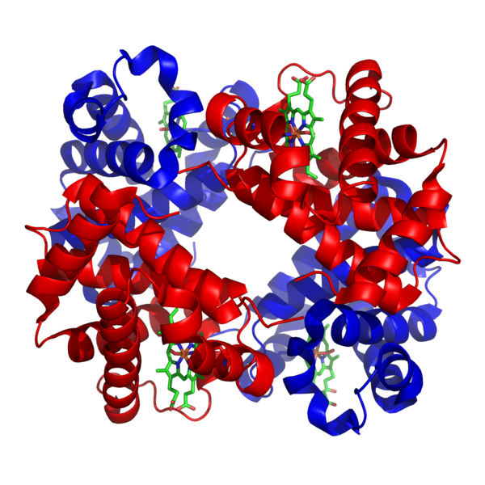
VSEPR and
Molecular
Geometry
Hemoglobin

Slide 2
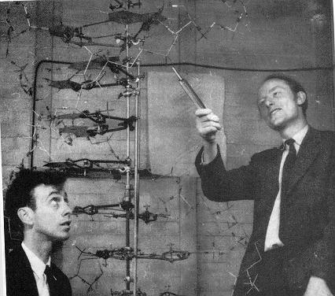
Models
Models are attempts to explain how nature operates on the microscopic level based on experiences in the macroscopic world.
Models can be physical as with this DNA model
Models can be mathematical
Models can be theoretical or philosophical

Slide 3
Fundamental Properties of Models
A model does not equal reality.
Models are oversimplifications, and are therefore often wrong.
Models become more complicated as they age.
We must understand the underlying assumptions in a model so that we don’t misuse it.

Slide 4
VSEPR Model
(Valence Shell Electron Pair Repulsion)
The structure around a given atom is determined principally by minimizing electron pair repulsions.

Slide 5
Predicting a VSEPR Structure
Draw Lewis structure.
Put pairs as far apart as possible.
Determine positions of atoms from the way electron pairs are shared
Determine the name of molecular structure from positions of the atoms.

Slide 6

Steric Number 1
1 atom bonded to another atom
Steric No. | Basic Geometry 0 lone pair | 1 lone pair | 2 lone pairs | 3 lone pairs | 4 lone pairs
1 | linear

Slide 7


Steric Number 2
2 atoms, or lone electron pairs, or a combination of the two, bonded to a central atom.
Steric No. | Basic Geometry 0 lone pair | 1 lone pair | 2 lone pairs | 3 lone pairs
2 | linear | linear

Slide 8

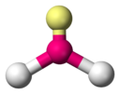

Steric Number 3
3 atoms, or lone electron pairs, or a combination of the two, bonded to a central atom.
Steric No. | Basic Geometry 0 lone pair | 1 lone pair | 2 lone pairs | 3 lone pairs
3 | trigonal planar | bent / angular | linear

Slide 9
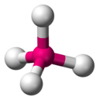
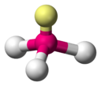
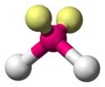
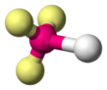
Steric Number 4
4 atoms, or lone electron pairs, or a combination of the two, bonded to a central atom.
Steric No. | Basic Geometry 0 lone pair | 1 lone pair | 2 lone pairs | 3 lone pairs
4 | tetrahedral | trigonal pyramid | bent / angular | linear

Slide 10
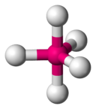
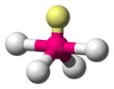

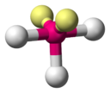
Steric Number 5
5 atoms, or lone electron pairs, or a combination of the two, bonded to a central atom.
Steric No. | Basic Geometry 0 lone pair | 1 lone pair | 2 lone pairs | 3 lone pairs
5 | trigonal bipyramid | sawhorse / seesaw | t-shape | linear

Slide 11
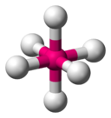
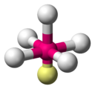
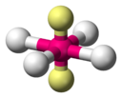
Steric Number 6
6 atoms, or lone electron pairs, or a combination of the two, bonded to a central atom.
Steric No. | Basic Geometry 0 lone pair | 1 lone pair | 2 lone pairs | 3 lone pairs
6 | Octahedral | square pyramid | square planar

Slide 12
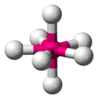
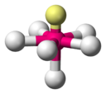
Steric Number 7
7 atoms, or lone electron pairs, or a combination of the two, bonded to a central atom.
Steric No. | Basic Geometry 0 lone pair | 1 lone pair | 2 lone pairs | 3 lone pairs
7 | pentagonal bipyramidal | pentagonal pyramidal

